Slide 1


MIAD
Maestría
en Inteligencia Analítica de Datos

Slide 2



MIAD
Kirin USA, Inc.: Ichiban Shibori
Maestría
en Inteligencia Analítica de Datos
Sesión sincrónica
Ejercicio semana 5

Slide 3



The meeting lasted three hours. Members of the Kirin new product development team, marketing consultants, and two executives from the advertising agency met at the Kirin USA offices in New York City to review marketing research findings and decide next steps for the new product project. The pressure to launch a new product was mounting, although it was not yet a crisis.
The intent was to formulate a new beer product that would be based on Kirin’s successful formulation of "Ichiban Shibori," a new beer that had received enthusiastic reception in Japan. The objective was to identify an opportunity in the U.S. import beer market so that the team could design a new product and marketing program around the Ichiban Shibori formulation, including changing product ingredients if necessary.
One issue was to identify potential market segments that defined the market for imported beers. The team would then have to decide upon one or more of these segments and build a new product concept to meet the needs of the segment. The discussion surfaced several suggestions, including concentrating on a narrow segment of heavy users, positioning the new product for one or two attractive segments, or positioning it across all segments to reach the broadest possible market and sales response. However, no clear consensus appeared to emerge at the meeting. It was February 1991 and there was a sense of urgency about the decision.
Kirin USA's New Product Development Launching a new beer into the crowded U.S. import market was not viewed as an easy task by Kirin USA’s management. Yet it was seen as the best way to achieve their growth goals without jeopardizing their existing customer base. To surpass Sapporo in the U.S. by 1993 Kirin managers believed they needed to sell an additional 300–400,000 cases of beer each year from their current one million case volume. This also had to factor in any possible losses due to cannibalization of existing Kirin products. Kirin had Lager, Light, Draft, and Dry products on the market.

Slide 4
Among its major questions, the new product team was most concerned with identifying the U.S. import beer segments that would respond most favorably to a new Kirin product concept. Because buyer behavior for beer relied on image, they needed to know what product concept or imagery should be developed and, more specifically, what product features defining the concept would obtain a favorable market response.
The team also wanted to know who the potential consumers in each segment were and what were their needs, lifestyles, attitudes, media usage habits, and demographics. To provide the necessary information and decision support for addressing the major market issues, Mr. Kazuhiro hired your consulting firm to design and conduct a market study.
Marketing Research and Analysis for the New Product The first phase of the research process was a series of exploratory focus groups to study in-depth aspects of import beer drinking. The results of the study were used to identify the major attributes of import beer that beer drinkers considered. In addition, the results were used to formulate a comprehensive questionnaire that would be delivered in two phases. The first phase was designed to gather the bulk of the data needed for the segmentation analysis, and the second phase follow-up was designed to more carefully evaluate specific product feature tradeoffs within the segments.
After pretesting the questionnaire for the first phase of the study, a data collection agency was retained to complete telephone interviews with a random sample of some 400 drinkers of imported beer. The questionnaire contained questions that provided data on a variety of variables, including the attributes consumers used in deciding on import beers, the importance of these attributes, perceptions of Kirin and its competitors on these attributes, usage occasions, demographics, attitudinal characteristics, and media usage.

Slide 5
Twenty-one attributes were selected from the focus group study to represent the criteria that consumers might use to decide on import beer brands. A comparison of Kirin's ratings on the 21 attributes against more popular and heavily advertised brands (Molson, Heineken, Corona) revealed that the Kirin brand name was not as well perceived as its competitors. This was expected however, since Kirin did very little national advertising compared to these major imports.
Survey respondents also rated the importance of each of these attributes on a 0 – 9 scale. The consulting company is considering whether these importance ratings could be used to identify market segments using cluster analysis.
To help describe consumers who were classified into each segment, several descriptor variables were included in the survey. They included a variety of factors that might help explain import beer consumption: demographics, consumer self-perception, and beer consumption.
Conjoint Analysis Study and Choice Simulation The second phase of the study involved a follow-up mail survey of the entire sample. This questionnaire included a conjoint analysis data collection task, with a follow-up telephone call to obtain respondent preferences for various combinations of a new import beer. Conjoint analysis was helpful to obtain consumer preferences in terms of tradeoffs among the various attributes of beer, including its price.
Over the telephone they were asked to rank order their preferences for the different import beers described on the various cards. The conjoint analysis was based on seven attributes of import beer, each at three levels. The attributes and levels were chosen by the managers and consultants with reference to key new product decisions that had to be made.
The preference data from conjoint analysis was obtained for each individual in the sample. These results could then be used to form new segments (using cluster analysis) or to be analyzed according to existing segments.

Slide 6
The brands were organized into meaningful groups. For example, the Canadian, Mexican, and Japanese beers were defined as three groups of brands. This was done to focus more on major types of beer concepts than specific brands. Although a variety of assumptions could be employed to define the new beer concept, the major concern of managers had to do with taste. The base case product was defined as a beer with regular body and mild aftertaste, while the new product concept was defined as a beer with rich full-bodied taste with no aftertaste.
The Key Decisions To get the best new product formulation possible. To develop a careful assessment of the market opportunity for the new product, as well as evaluate alternative new product concepts for the beer. Which segment or segments to choose, what concepts would be appropriate for segments, and what marketing budgets should be employed.

Slide 7
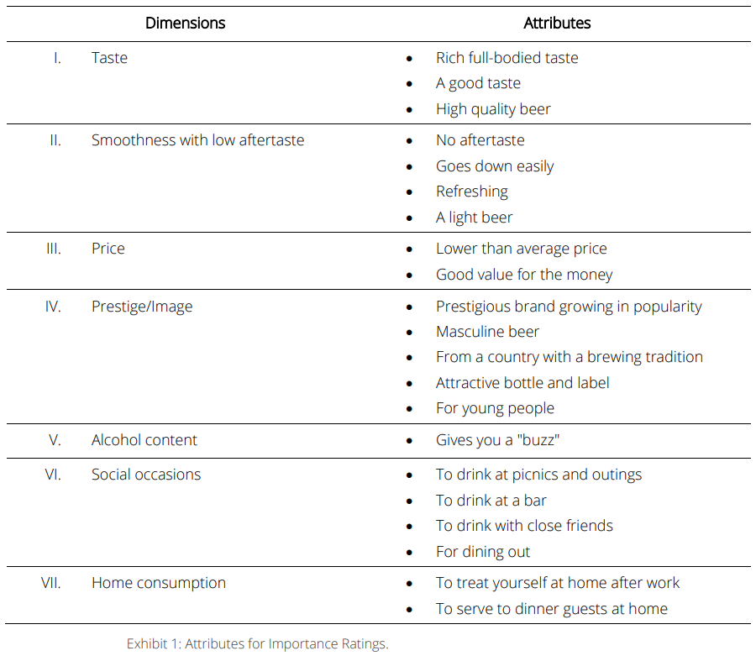

Slide 8
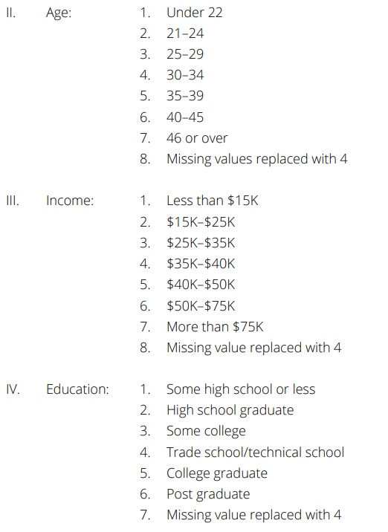
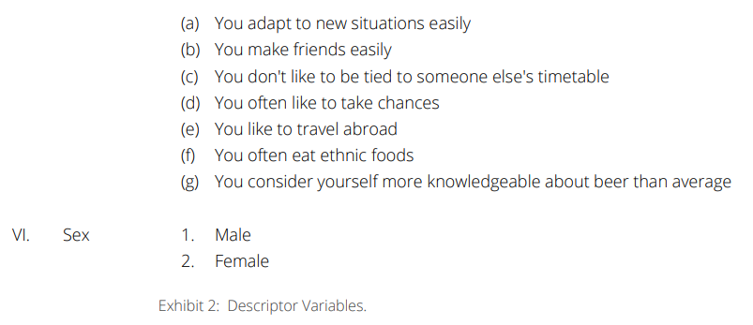
I. Weekly consumption: Bottles/cans/glasses of imported or domestic beer consumed during the previous week
V. The following items measured on 1–4 scale with 1 being Strongly Disagree and 4 being Strongly Agree

Slide 9
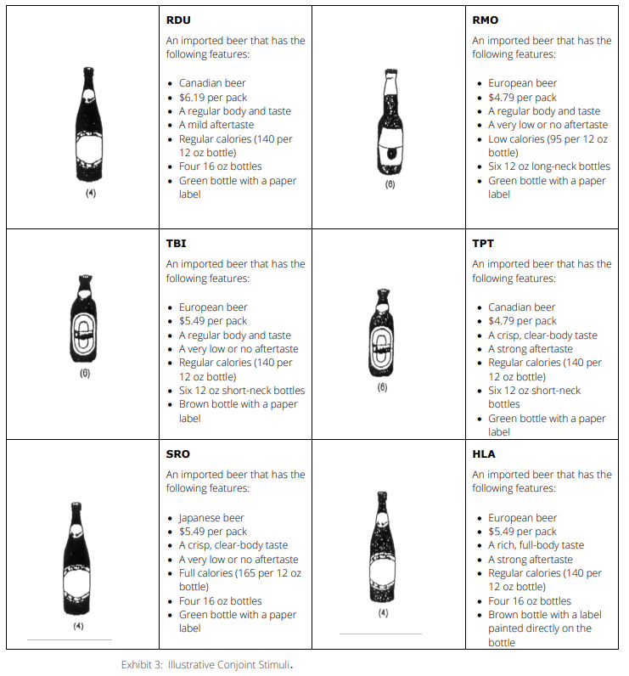

Slide 10
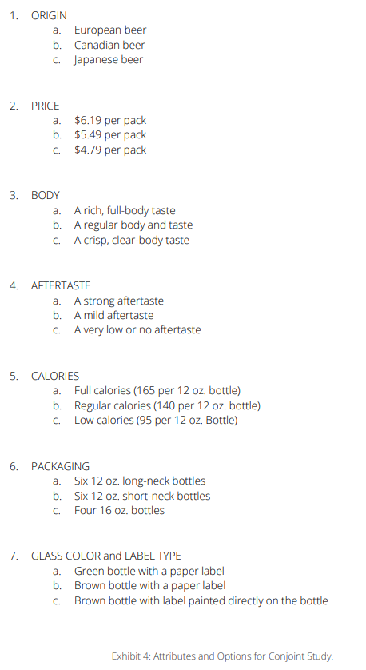

Slide 11
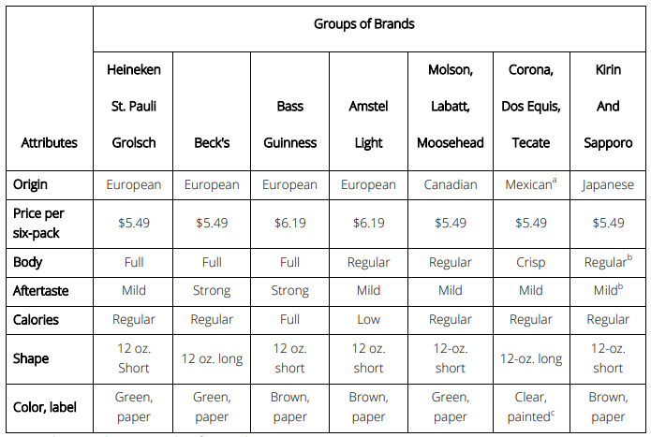
Exhibit 5: Profiles of Major Competitor Sets Used in Choice Simulation.
Exhibit 5: Profiles of Major Competitor Sets Used in Choice Simulation.

Slide 12
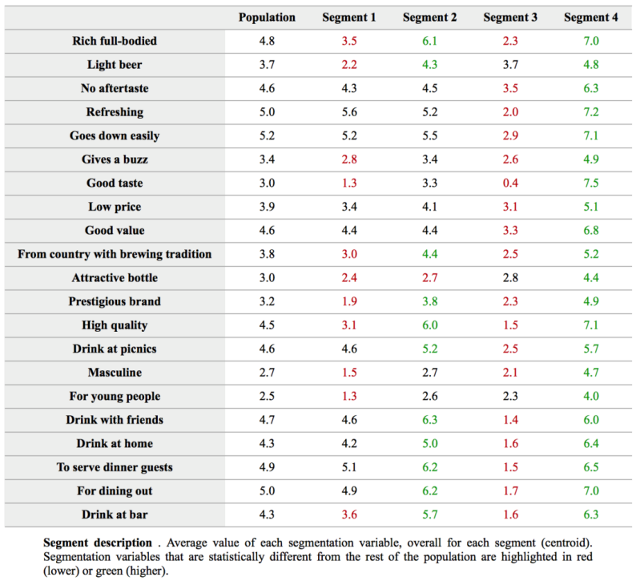
Solution The case does not list a specific set of questions for the students to explore but describes an interesting decision context from which the students should develop the appropriate set of issues/questions to explore because Kirin is a niche product, it probably does not appeal to everyone. Therefore, any sophisticated analyses here should also include consideration of segmentation and targeting issues.
1. First, do a traditional needs-based segmentation analysis to determine if the import beer market could be segmented in a useful way. Determine if there are any targetable segments that emerge from this analysis. It turns out that although there are need differences between the segments, we get poor discrimination among the segments. Overall, a four-segment solution appears to be the best. Here is a summary of the results for the four-segment solution:

Slide 13
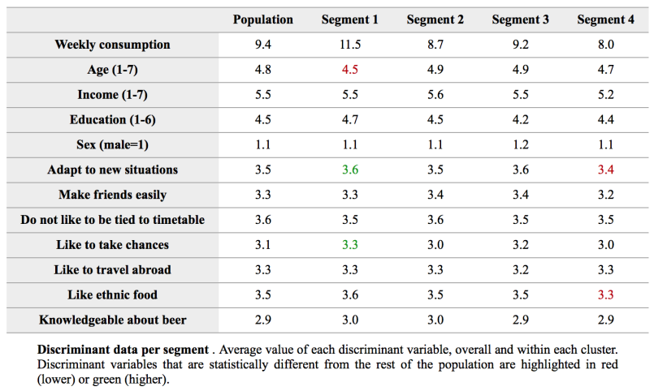
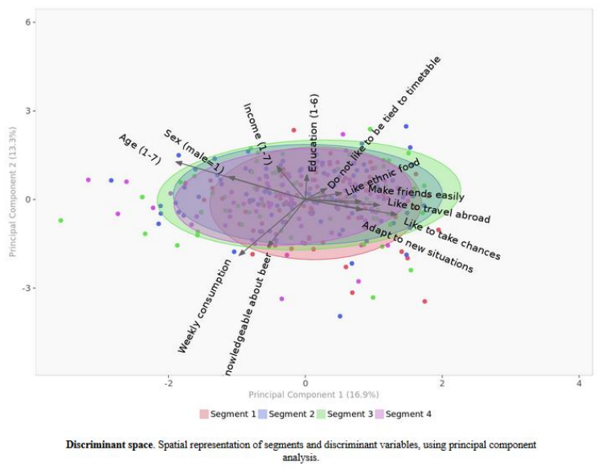
Segments 2 and 4 are particularly appropriate for targeting with the current Kirin formulation as a full-bodied beer with no aftertaste (case, p. 2). However, the discriminant analysis suggests that these segments are not easy to identify and target – there are no significant differences between the segments on the profile variables the company is considering. (In some sense beer is an egalitarian drink and beer drinkers and their tastes are distributed across all demographic and psychographic segments).

Slide 14
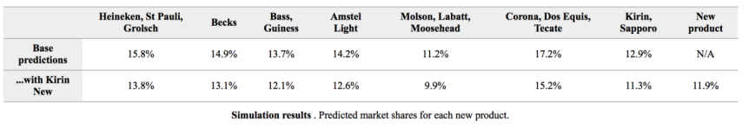
2. Run Conjoint analysis. Try to identify a product design that will enable Kirin to sell sufficient incremental cases. (The students can focus on market share as the primary criterion. It is important for students to explore which choice rule makes the most sense (most beer drinkers switch brands frequently, and therefore, a share-of-preference rule would be more appropriate than a first choice rule). Based on market share analysis, the new Kirin product being considered by the company gains a market share of about 12%, as shown in the table below.
Predicted market shares
Predicted market shares

Slide 15
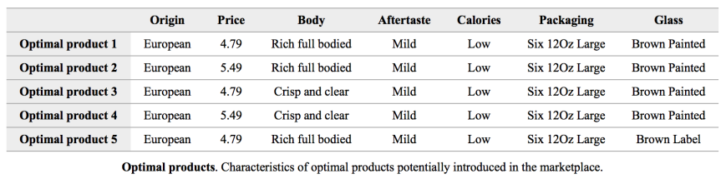
On the other hand, if an optimal product design is selected using the software, the product(s) that generate the highest market shares turn out to be one with the following characteristics:

Slide 16
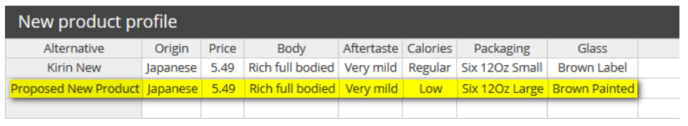
All top products have “European” as the origin and all have a predicted market share in the simulation of around 17% (significantly higher than the new product currently being considered by the company). Only the first, second, and fifth products have a rich full body that is consistent with the proposed formulation of the new Kirin product. Also, the proposed product has no aftertaste (Very mild), but consumers seem to want a mild aftertaste. Finally, only the second product has a price point consistent with Kirin’s image as a premium beer. Thus, a potential new product that the company could consider developing would then have the following attribute levels:

Slide 17
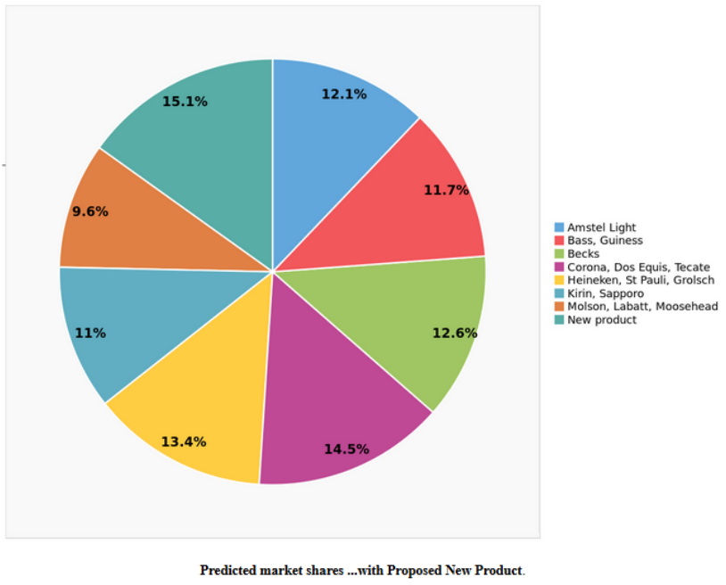
The market share for the proposed new product can be computed by including this product as an additional potential new product option for evaluation by the software. This proposed new product would generate a market share of 15%, instead of the 12% for the product the company is considering:

Slide 18
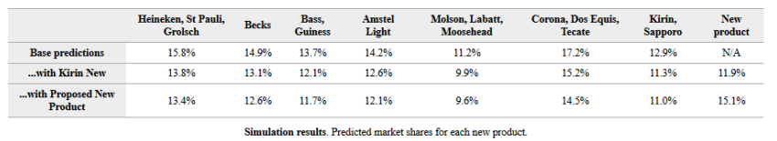
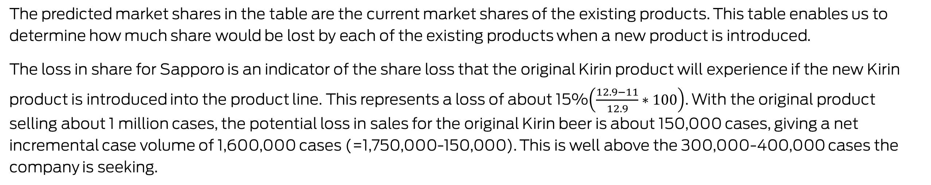
Assess potential cannibalization, i.e., check if there is a substantial loss in market share for the original Kirin product as a result of introducing the new Kirin product. To determine the extent of cannibalization, we can do a “Before-After” analysis as follows. One of the outputs produced by the software is the following table.
Predicted market shares
The predicted market shares in the table are the current market shares of the existing products. This table enables us to determine how much share would be lost by each of the existing products when a new product is introduced.
The loss in share for Sapporo is an indicator of the share loss that the original Kirin product will experience if the new Kirin product is introduced into the product line. This represents a loss of about 15%$\left(\frac{12.9−11}{12.9}∗100\right)$. With the original product selling about 1 million cases, the potential loss in sales for the original Kirin beer is about 150,000 cases, giving a net incremental case volume of 1,600,000 cases (=1,750,000-150,000). This is well above the 300,000-400,000 cases the company is seeking.

Slide 19
Other analyses. At this point, it may be worth checking if there are distinct segments of consumers who might prefer the proposed new product. To do this type of segmentation, the students need to create a new data file containing the part worth data with the discrimination data Such an analysis reveals that a four-segment solution makes the most sense in terms of identifying distinct groups of consumers with different needs:
Segment 2 could potentially be an attractive segment to target given its stronger preference for Japanese full-bodied beer. Segment 4 could also be potentially attractive. Unfortunately, there is not sufficient discrimination among the profile variables to target this segment (the only significant difference is that segment 2 consists of consumers with more education, and perhaps more income). However, overall, there is better discrimination here than with the needs-based segmentation using generic needs that we had outlined earlier.

Slide 20
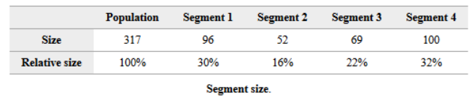
Segment description

Slide 21
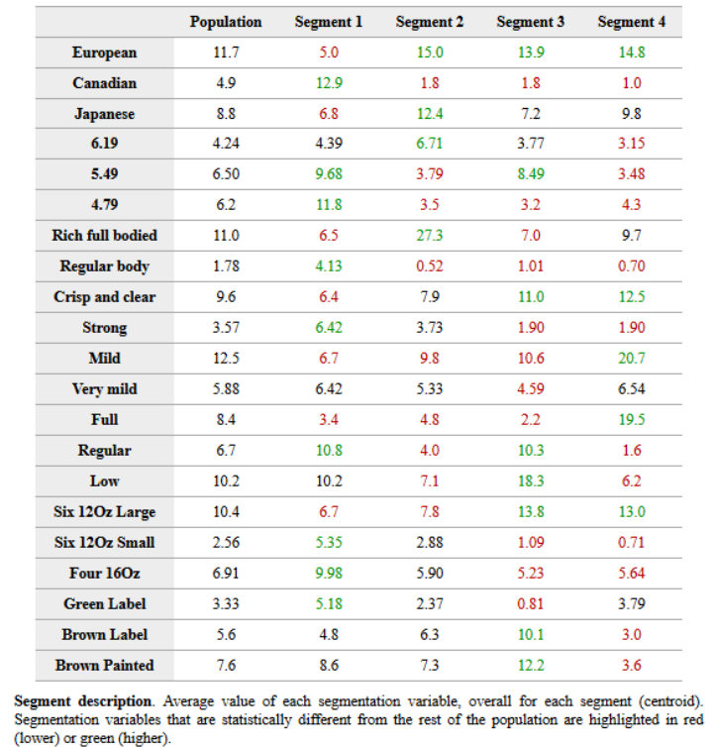

Slide 22
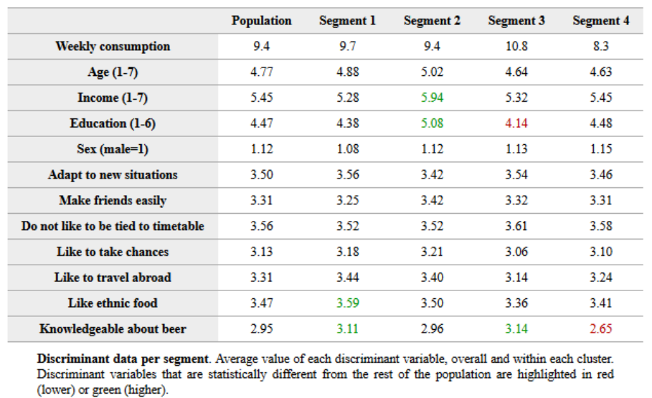

Slide 23
Cluster analysis, based either on generic needs or conjoint partworths, suggest a 4-cluster solution. Unfortunately, discriminant analysis suggests that there are not many observable differences between the need-based clusters on the demographic variables considered by the company. No wonder, most leading beer companies rely on psychographics such as "liking for sports (e.g., football and baseball)," rather than demographics to target their customers.
Within Conjoint Analysis, the unconstrained optimal product (under the share of utility rule) is a European beer, $4.79, full-bodied, Mild aftertaste, low cal, Six 12oz large bottles, and brown paper label. This beer can garner 18% share, compared to the 12% share for the new beer being considered by the company. However, a Japanese beer cannot claim to be European! Therefore, we considered a new product that was of Japanese origin, but included several key attributes associated with the optimal products.
The prospect of finding segments that have distinct needs but are not easily targetable is a problem that occurs often in commercial segmentation studies. In such cases, the company can potentially find attitudinal or psychographic differences between segments and use that knowledge in creating advertising that resonates with the appropriate segments, with the hope that members of the segment recognize that the ad is meant for them.

Slide 24


Marketing
Analytics
MIAD
Maestría
en Inteligencia Analítica de Datos

